Slide 1
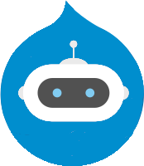
Practical Applications of AI Chatbots in Drupal
Rick Torzynski
Senior Drupal Developer, ECS
Sponsored by Esteemed

Slide 2



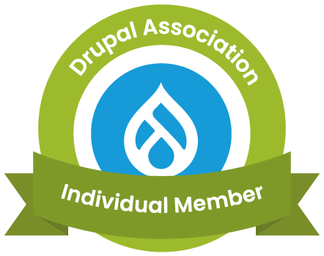
About Me
I've been a Drupal Developer for 13+ years, currently working on United States government agency Drupal websites, healthcare Drupal websites, machine learning applications, and software engineering.
Senior Drupal Developer
Drupal Developer at Florida Blue
Senior Software Engineer
Drupal Username: mandolinrick

Slide 3
Our Agenda
History of Chatbots
Why Use a Chatbot?
Chatbot Frameworks
Machine Learning/Deep Learning
Chatbot Basics
How Chatbots Learn
Demo
Looking to the Future
Questions?

Slide 4
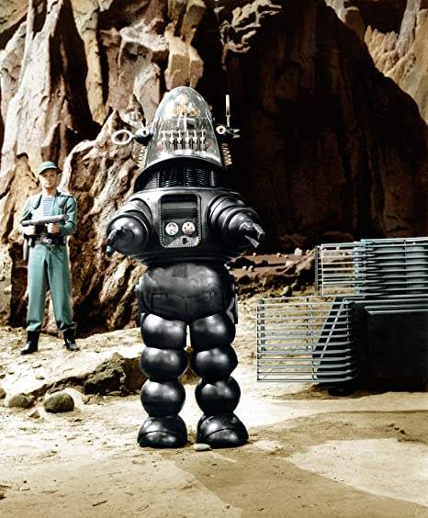
Robby the Robot
The Forbidden Planet (1956)

Slide 5
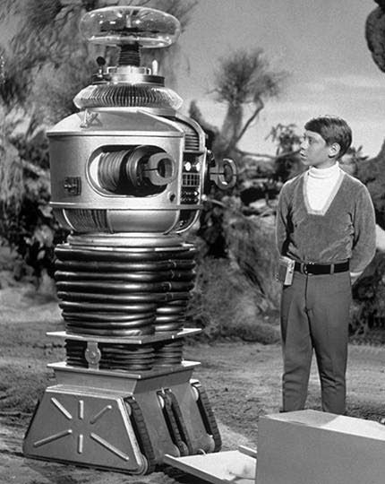
B9 Space Robot
Lost in Space (1965-1968)

Slide 6
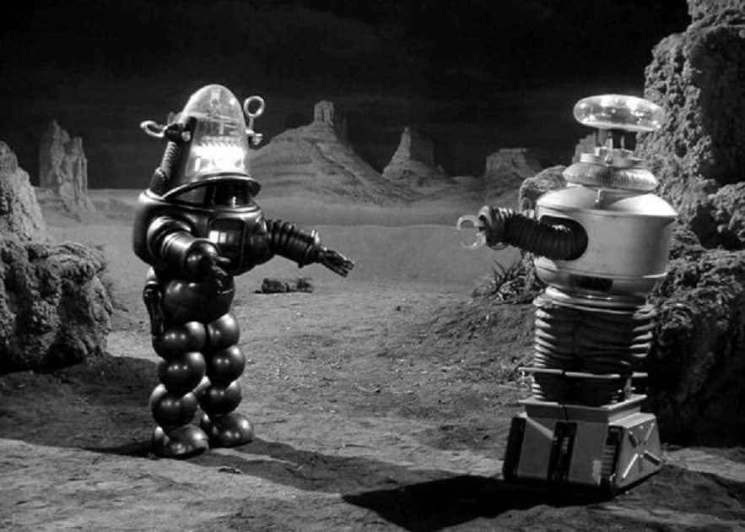
Robby versus B9 Space Robot
Lost in Space (1968)

Slide 7
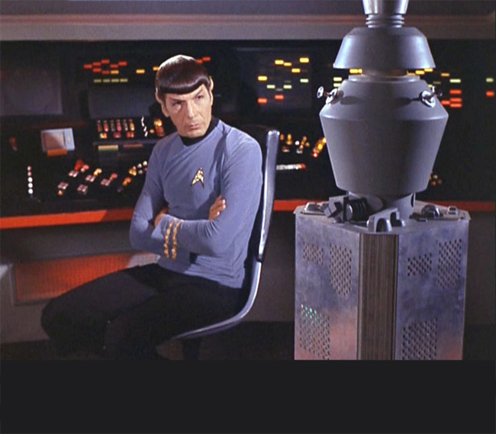
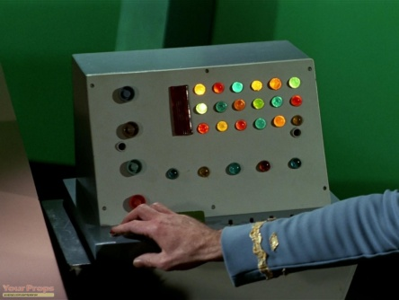
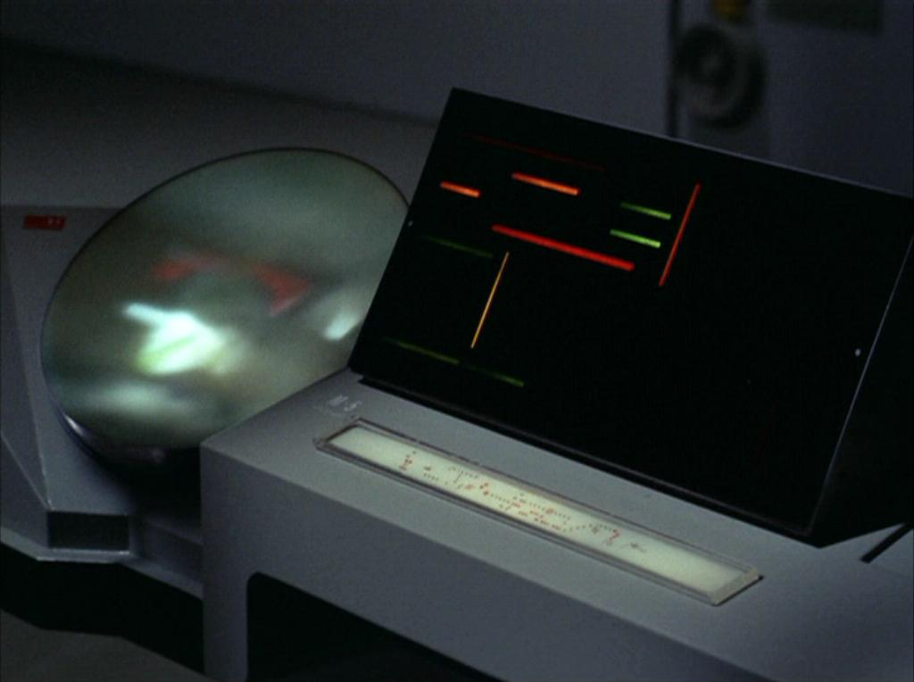
Star Trek Computers
Star Trek (1966-1969)
Computer
Nomad
M-5 Multitronic System

Slide 8
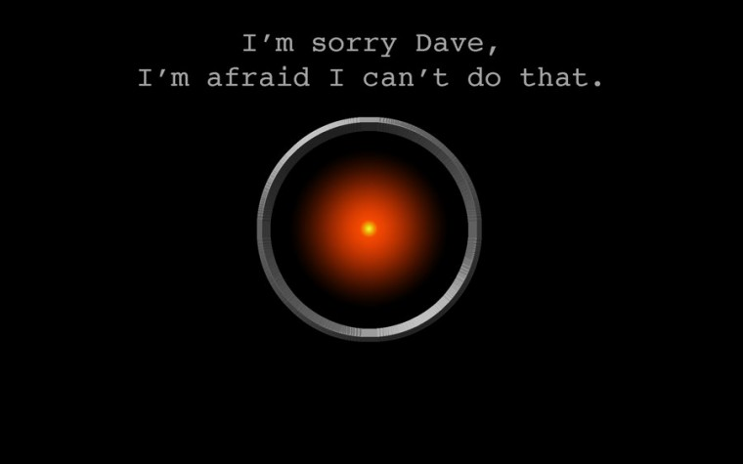
Hal 9000
2001: A Space Odyssey (1968)

Slide 9
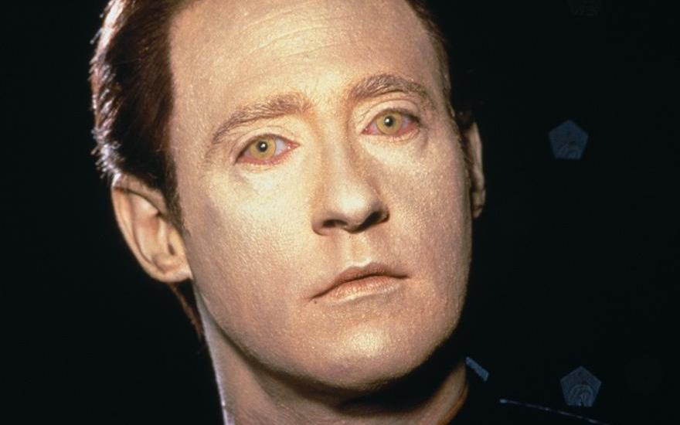
Data
Star Trek: The Next Generation (1987-1994)

Slide 10
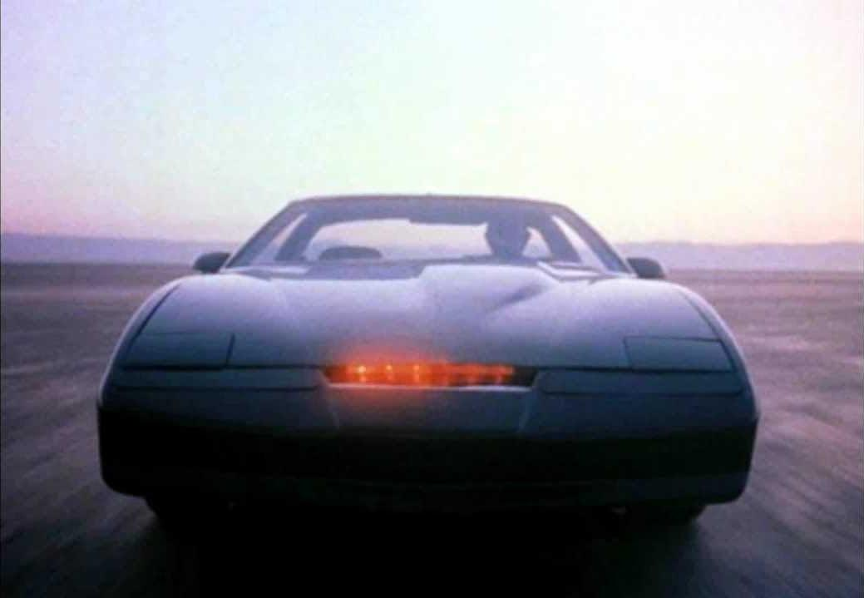
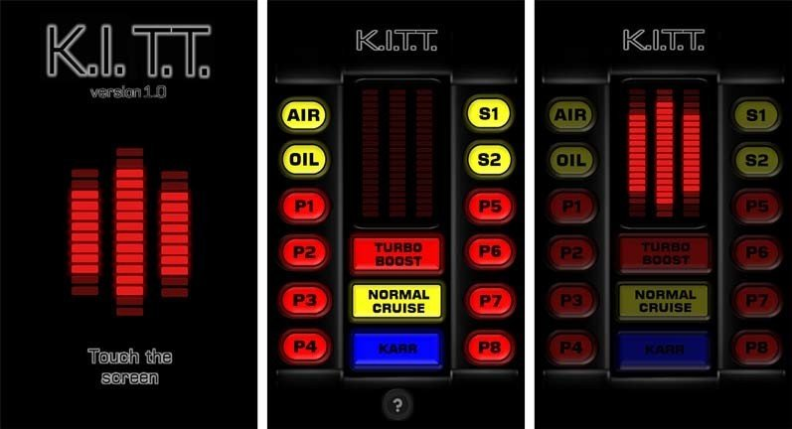
K.I.T.T.
Knight Rider (1982-1986)

Slide 11
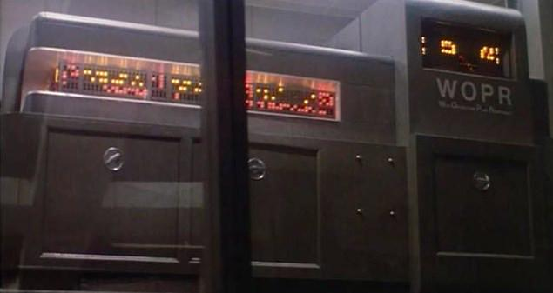
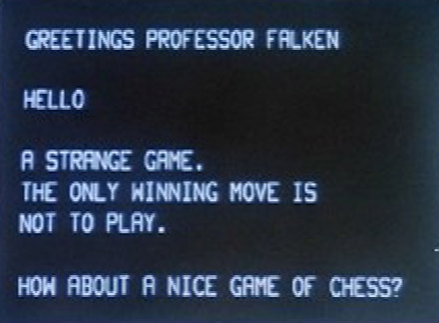
Joshua (WOPR)
Wargames (1983)

Slide 12
History of Chatbots
1964
1990
2010
2017
Operational
Statistical
Neural Methods
Transformers
Symbolic rule-based
Eliza (1964)
Eliza Bot
Eliza Bot Github
Bayesian
Markov Chains
Neural Networks
GPU use
RNN
LSTM
Seq2Seq
ML Happening!
Apple Siri (2011)
Google Now (2012)
MS Cortana (2013)
Amazon Alexa (2014)
Google Assistant (2016)
BERT: 340M (OS)
GPT-3: 175B
GPT-J-6B: 6B (OS)
Switch Transformer: 1.7T (OS)
GPT-4: 100T
GPT-J-6B Demo

Slide 13
Why Use a Chatbot?
24/7 Availability
Generate more conversations
Can handle multiple customers
Not subject to mood swings
Collect and analyze data
Personalize Conversations
Multilingual
Automate processes
Can be deployed anywhere

Slide 14


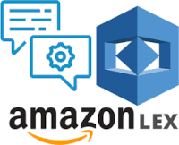

Chatbot Providers and Frameworks

Slide 15
Why Choose Rasa?
Pros
Cons
Open source
Uses YAML for configuration and content files
Well documented RESTful API
Active development
Excellent support
Documentation
Active YouTube channel
Office hours
Cutting edge models and pipelines
Graph based development pipeline in 3.0 to greatly reduce training time
Customizable
Written in Python
Model development - Python
Model inference - JavaScript
Requires machine learning education/development
Needed for meaningful development
Complex
Needed for extreme customization
Requires creation of knowledge base/training stories
Single domain chatbot
AnswerThePublic.com
Excellent source material

Slide 16

Machine Learning
"Machine learning focuses on applications that learn from experience and improve their decision-making or predictive accuracy over time." - IBM

Slide 17
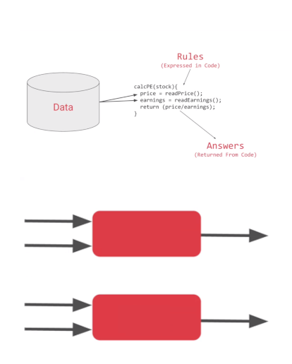
Machine Learning
Types of Machine Learning
Supervised Learning - for a set of data, the outcome is known (linear regression, classification)
Unsupervised Learning - outcome unknown, but interested in how data clusters together into groups (PCA, Recommender)
Programming Paradigm
Traditional Programming
Data/Input + Rules = Answers
Machine Learning
Data/Input + Answers = Rules
Rules
Traditional
Programming
Answers
Data
Answers
Data
Machine
Learning
Rules
Diagram: Moroney, L. (2021). AI and Machine Learning for Coders: A Programmer’s Guide to Artificial Intelligence. O’Reilly.

Slide 18
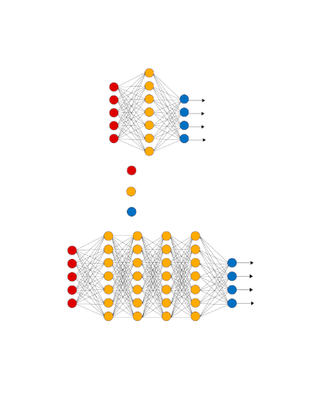
Deep Learning
“A subfield of machine learning concerned with algorithms inspired by the structure and function of the brain called artificial neural networks.”
Input Layer
Input Layer - Images, text, audio, video, numbers, etc. Must be quantifiable.
Hidden Layers - Filters for feature extraction
Output Layer - Classification, prediction
Activation function - takes in the output signal from the previous cell and converts it into some form that can be taken as input to the next cell.
Sigmoid, ReLU and Softmax
Hidden Layer
Output Layer

Slide 19
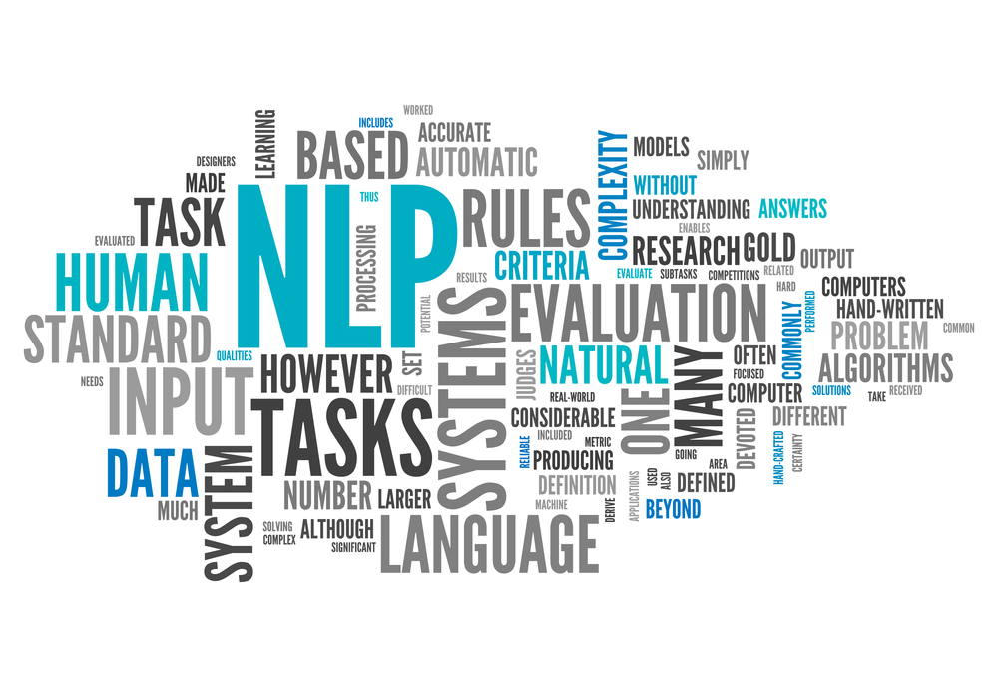
Deep Learning
Components of NLP
Natural Language Processing (NLP)
NLP is a subset of AI and is what happens when computers read language. NLP turns language into structured data.
Parsing, tokenizing, stemming, text summarization, text categorization, wordclouds etc.
Natural Language Understanding (NLU)
NLU is a subset of NLP and is what happens when computers understands language.
Sentiment detection, topic classification, entity detection are examples
Natural Language Generation (NLG)
NLG is what happens when computers writes language. NLP turns structured data into language.
Examples include text generation, story generation, music generation and chatbot responses.

Slide 20
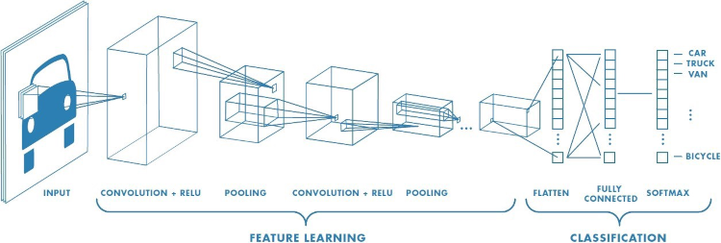
Deep Learning
Convolutional Neural Network

Slide 21
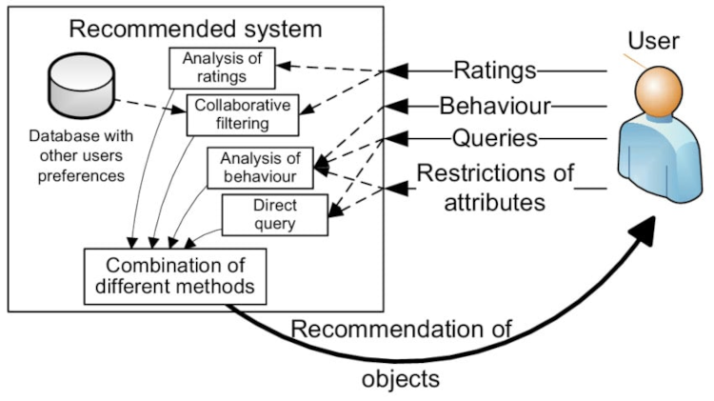
Deep Learning
Recommendation Engine

Slide 22
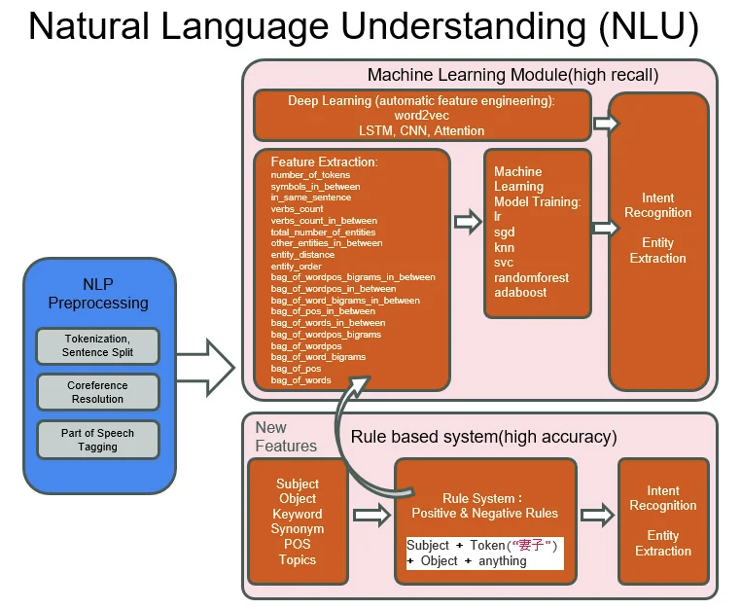
Deep Learning

Slide 23
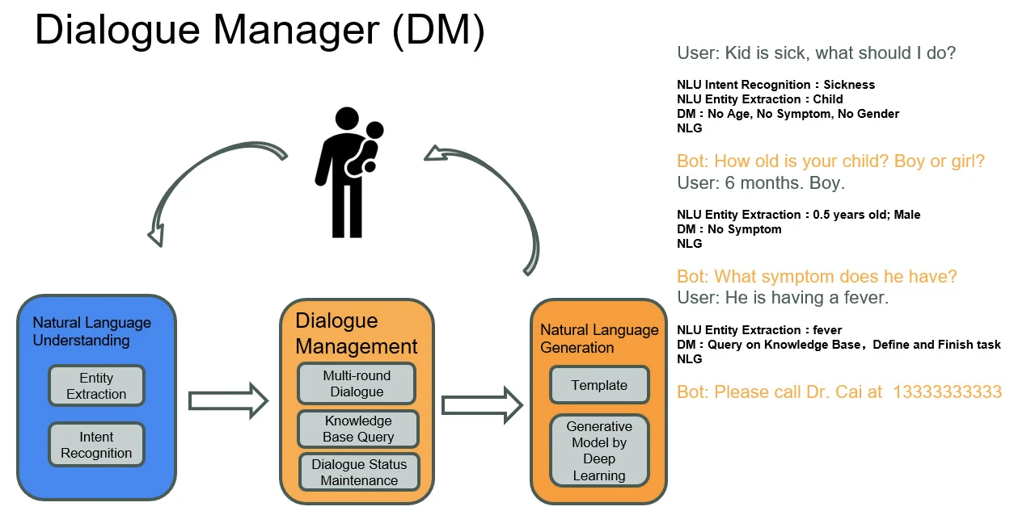
Deep Learning

Slide 24
How Chatbots Work
Intent Recognition/Classification
What the user wants to do
Raw text in, machine readable information out
Can also be rule-based or regex
Neural Models such as transformer models (BERT, DIET)
Dialogue Management
Dialogue Policy - what should the chatbot do next based on the conversation
Uses some rules
Transformer Embedding Dialogue (TED) Policy - selects which action to take next
Requires training examples
Response and/or Action Taken
Action can be utterance
Action could be an automated process or call to another API
Another step in the conversation

Slide 25
Components of Intent Based Chatbot
Intents
What the user wants to do
Entities
Important pieces of information
Stories
Ways the conservation can go
Training data
Actions
What action the chatbot can take
Slots
Key, value pair acts as memory of the chatbot

Slide 26
Installing and Configuring Rasa
# For Ubuntu
$ sudo apt update
# Install python3.8 (max)
$ sudo apt install python3.8 python3-pip
# Create virtual environment
$ python3 -m venv ./venv
# Activate venv environment
$ source ./venv/bin/activate
# Make sure latest version of pip3
(venv)$ pip3 install -U pip
# Install Rasa
(venv)$ pip3 install rasa
# Create starter chatbot
(venv)$ rasa init
(venv)$ rasa train
(venv)$ rasa shell
(venv)$ rasa run --enable-api --model ./models --endpoints ./endpoints.yml --cors "*"
…/Rasa/chatbot
…/actions
…/actions.py
…/__init.py
…/config.yml
…/credentials.yml
…/data
…/nlu.yml
…/rules.yml
…/stories.yml
…/domain.yml
…/endpoints.yml
…/tests
…/test_stories.yml

Slide 27
Installing and Creating Custom Component Module
Create AI Chatbot Rasa Component
Install Component Module
Enable Component Module
Create custom ai_chatbot module
Create Page content type
Add AI Chatbot Comp Rasa block to body section.
File Structure
…/web/modules/custom/ai_chatbot
…/ai_chatbot
…/ai_chatbot.info.yml
…/components
…/comp_rasa
…/comp_rasa.component.yml
…/index.html
…/css
…/Chatroom.css
…/js
…/Chatroom.js
…/rasa.js

Slide 28
Demo
Configure Rasa
Create data/nlu.yml
Create data/stories.yml
Create domain.yml
Train Model $ rasa train
Start up rasa server:
rasa run --enable-api --model ./models --endpoints ./endpoints.yml --cors "*"
Guidelines for First Chatbot
~10 Intents to start with
Simple Intents
Use expert knowledge
Use AnswerThePublic.com to get list of most popular domain questions
Create Custom Component Module
Create ai_chatbot_info.yml
Create comp_rasa.component.yml
Create index.html
Create rasa.js
In admin Structure->Block layout
In Content Region -> Place Block
Select AI Chatbot Comp Rasa block
Uncheck Display Title
In Visibility -> Pages restrict block to content url
Save Block

Slide 29
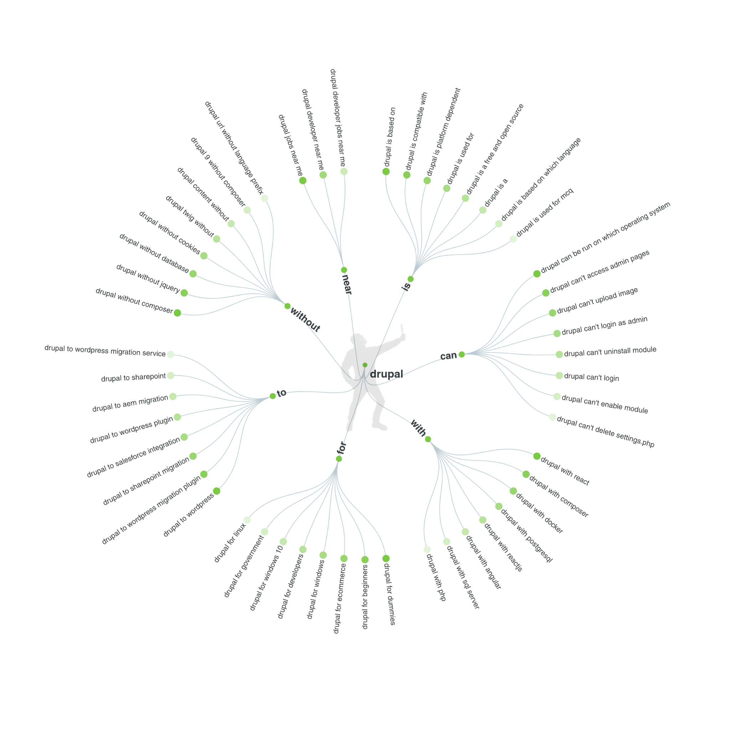
Who
1. Drupal who's online
2. Drupal who uses
3. who owns drupal
4. who created drupal
5. who makes drupal
What
1. what drupal theme is that
2. what drupal is used for
3. what drupal version do i have
4. what drupal version
5. what drupal site
Which
1. which drupal stack is used for installation
2. which drupal version
3. which drupal theme is used
4. which drupal version am i running
5. drupal which database
Where
…
Answer the Public Results

Slide 30
Domain Knowledge of DropBot
1. greet - hello
2. goodbye - bye
3. affirm - yes
4. deny - no
5. bot_challenge - who are you?
6. define - what is drupal?
7. creator - who created drupal?
8. creation - when was drupal created?
9. release_7 - when was drupal7 released?
10. release_8 - when was d8 released?
11. release_9 - when was d9 released?
12. release_10 - when will d10 be released?
13. end_of_life_7 - when does d7 reach end of life?
14. end_of_life_8 - when does d8 reach end of life?
15. end_of_life_9 - when is d9 no longer supported?
16. end_of_life_10 - when will d10 reach eol?

Slide 31
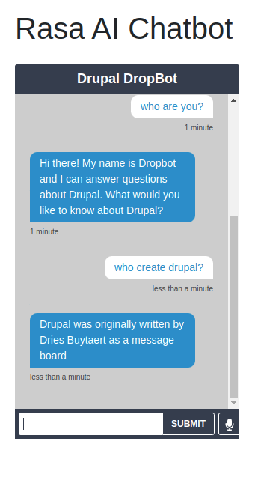
Drupal DropBot
Demo: http://drupalml.com/rasa-chatbot
Sample Questions
Who are you?
Who created Drupal?
When was it created?
When was Drupal7 released?
When was D8 released?
When does D8 reach end of life?
When was d10 released?
Rasa uses port 5005 by default

Slide 32
Looking to the Future
Continue to build up Drupal DropBot’s knowledge base
Add a real front-end to DropBot
I would like to start an initiative for integrating machine learning and AI into Drupal. If you would like to help with this, please let me know: ricktorzynski@gmail.com
I would like to start a YouTube channel featuring tutorials on integrated machine learning into Drupal

Slide 33
Thank You!
Matt Pritchard, Chris McGrath and my colleagues at Esteemed!
All Florida Drupal Camp organizers and volunteers!
I apologize for not being able to present this at Florida Drupal Camp, but a family emergency came up and I had to return to Jacksonville Florida

